Slide 1
Basic SQL
SQL Day 1 Class

Slide 2
Learning Objectives
By the end of this lesson, you will be able to:
Define SQL, statement, and query
Use SELECT to query fields from a table

Slide 3
What is SQL
SQL stands for Structured Query Language
Standard programming language for managing data in databases
Works with relational database management systems (RDBMS) like Oracle, MySQL, SQL Server, etc.
Declarative language - specify what data you want, not how to get it
English-like syntax, easy to learn and use
Notes:
Wide range of applications - web/mobile apps, analytics, ETL, etc.
In-demand skill for jobs involving databases

Slide 4
Why Learn SQL?
Essential for many technology roles:
Database Administrators
Data Analysts
Data Engineers
Application Developers
Understanding SQL enables working with data-driven systems
Opens opportunities in fields leveraging databases
Valuable addition to technical skill set

Slide 5
SQL Statements
SQL is written in statements - strings of characters that conform to formatting and syntax rules specified in the international standard
For example, a basic SELECT statement fetching data from a Customers table would be:
SELECT id, name, address
FROM Customers
WHERE state = 'CA’
ORDER BY name;

Slide 6
SQL Statements
Writing an SQL statement involves:
Specify the operation type:
This includes statements like SELECT, INSERT, UPDATE, DELETE. This tells the database engine what you want to do - query data, insert new data, update existing data, or delete data.
SELECT id, name, address
FROM Customers
WHERE state = 'CA’
ORDER BY name;

Slide 7
SQL Statements
Writing an SQL statement involves:
Specify the table and columns:
The statement needs to indicate from which database table and columns you want to access or operate on. Often this is done after the operation type using a FROM clause.
SELECT id, name, address
FROM Customers
WHERE state = 'CA’
ORDER BY name;

Slide 8
SQL Statements
Writing an SQL statement involves:
Specify any filtering conditions (optional):
You can filter which data rows you want using a WHERE clause and conditional logic.
SELECT id, name, address
FROM Customers
WHERE state = 'CA’
ORDER BY name;

Slide 9
SQL Statements
Writing an SQL statement involves:
Specify sorting/grouping (optional):
Statements like ORDER BY and GROUP BY can control row sorting and grouping in the output.
SELECT id, name, address
FROM Customers
WHERE state = 'CA’
ORDER BY name;

Slide 10
SQL Statements
Writing an SQL statement involves:
End with a semicolon:
All SQL statements are terminated with a semicolon ";"
SELECT id, name, address
FROM Customers
WHERE state = 'CA’
ORDER BY name;

Slide 11
Summary
SQL Data Querying - Best Practices
SQL enables powerful data retrieval & manipulation
Flexible data access across tables
Optimization for fast performance
Tips for Efficiency:
Focus queries only on required columns and conditions
Look for inefficient scans or expensive operators
Improve Over Time:
Start simple and targeted, add complexity gradually
Validate results at each iteration
Practice makes efficient SQL use

Slide 12
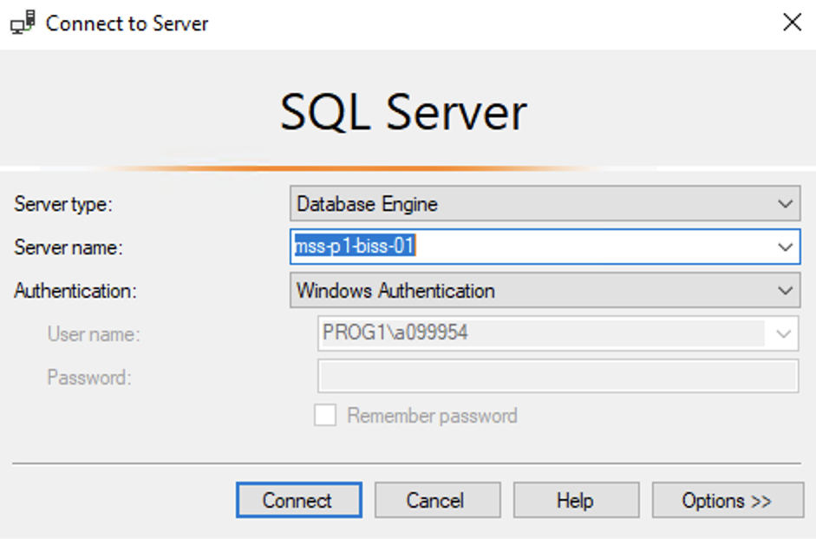
Hands On Examples
Using the AdventureWorks2012 Database
Please open up SSMS
Connect to BISS
Server = mss-p1-biss-01

Slide 13
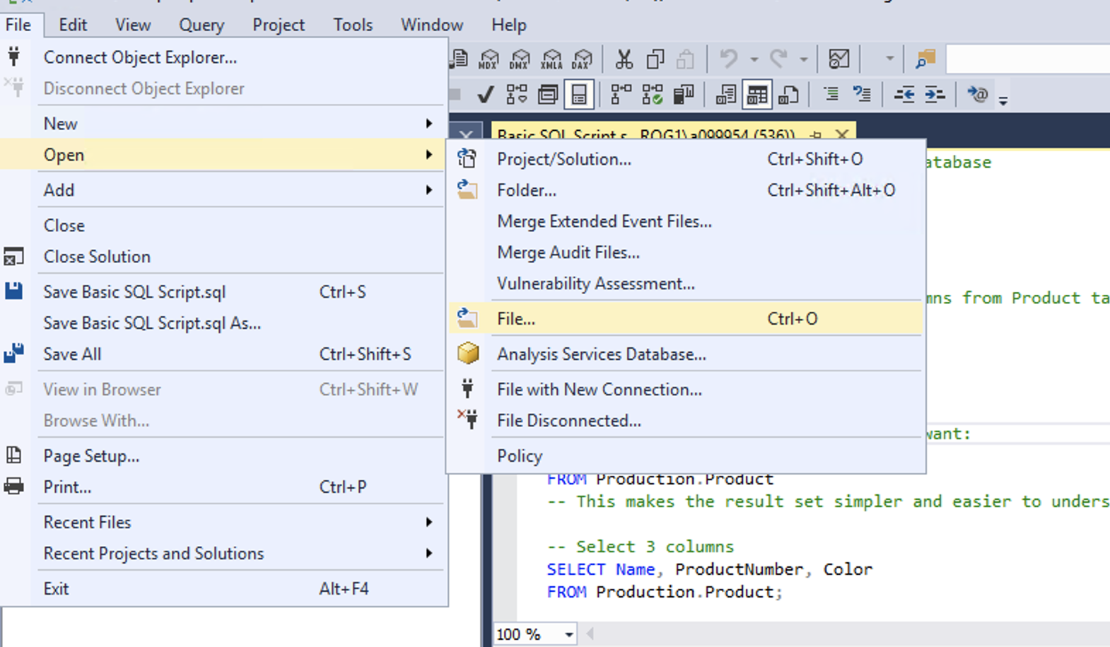
Hands On Examples
Click File -> Open -> File

Slide 14
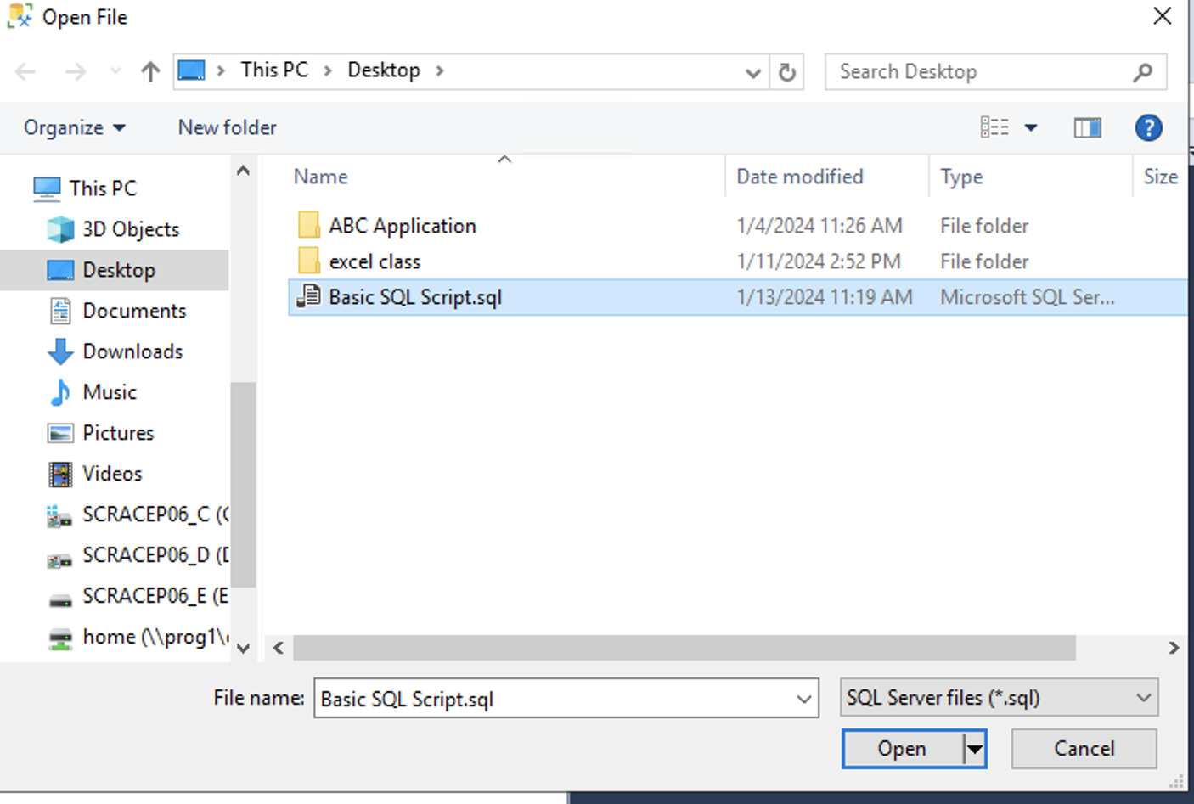
Hands On Examples
Open the SQL Day 1 Basic SQL Script.sql file
Notes:
Walk through each function

Slide 15
Exercise
Open the Day 1 Exercise.sql file
Answer the questions from each section
Notes:
Answers are stored in the Exercise Answers.sql file

